Slide 1


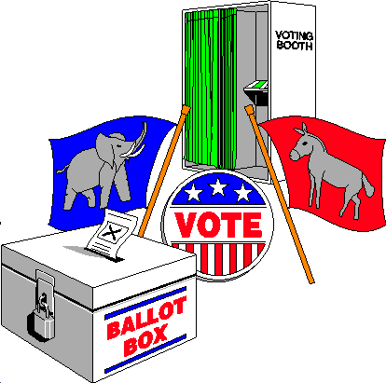
Future of Tuned Ratio Unbiased Mean Predictor (TRUMP) with the Unified Scrambling Approach (USA)
WATCH SLIDE SHOW IN PPT
2024 JOINT STATISTICAL MEETINGS
PORTLAND, OREGON
August 03-08
Sarjinder Singh and Stephen A. Sedory
Department of Mathematics
Texas A&M University-Kingsville
If you are here for the American politics, you are at wrong spot.

Slide 2
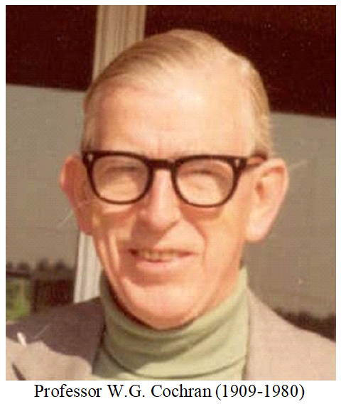
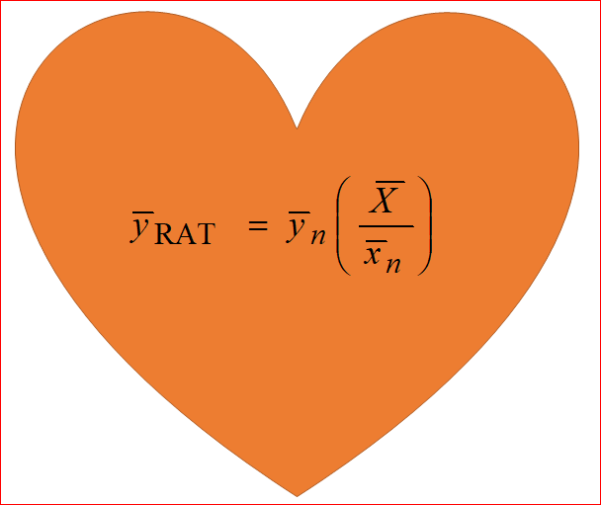
RATIO ESTIMATOR
INVENTED
THE RATIO ESTIMATOR
DURING 1940

Slide 3
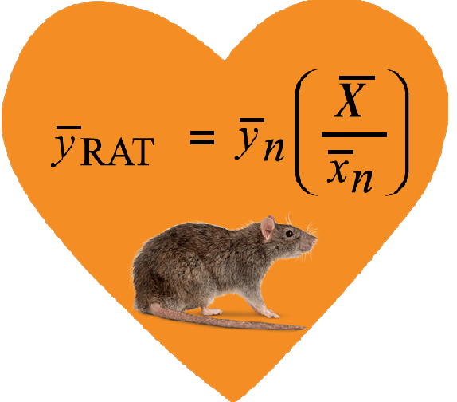






Under the linear model:
with assumptions:
(BLUE)
RATIO ESTIMATOR
BEST LINEAR UNBIASED ESTIMATOR

Slide 4
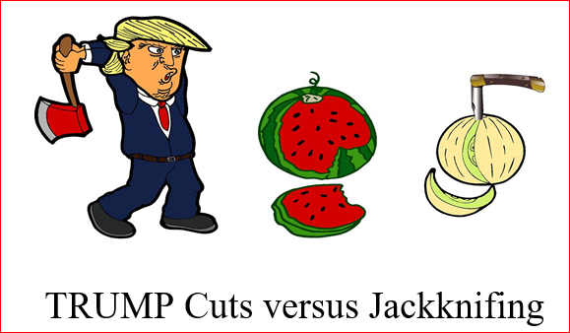
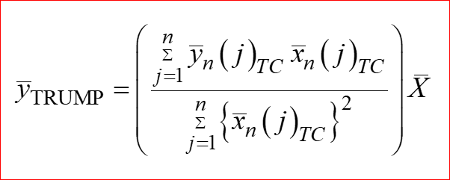
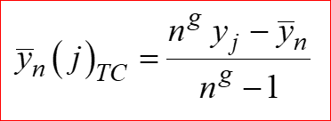
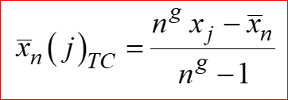
Tuned Ratio Unbiased Mean Predictor (TRUMP)
Singh and Sedory (2017):
where
are called TRUMP Cuts (TC).

Slide 5
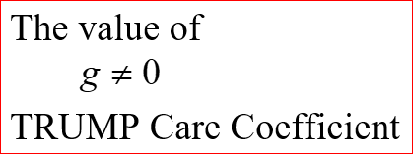


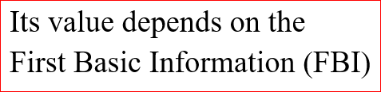

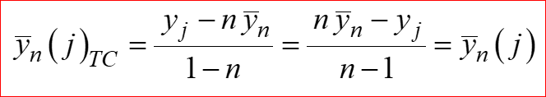

Slide 6


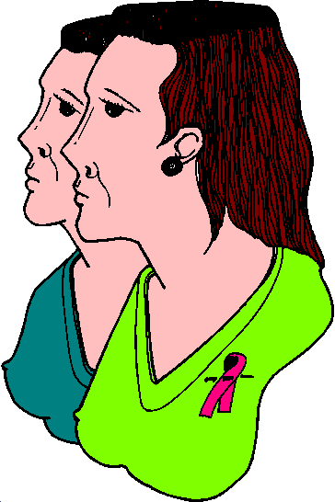




Need of Randomized Response Techniques
DAILY NEWS
DRUGS
AIDS
ALCOHOL
CRISES
POLLUTION
INNOCENTS@JAILS

Slide 7







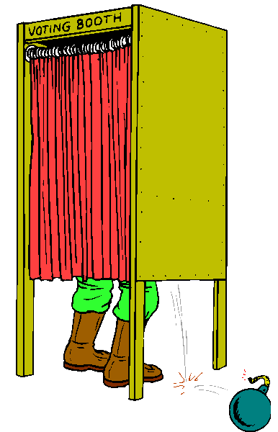
Need of Randomized Response Techniques
Smoking
Fraud: Tax, Social
Gangster/Murder
Extra-marital
Password-Hijackers
Abortions
Election Booth
Exam cheating

Slide 8



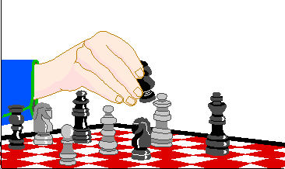

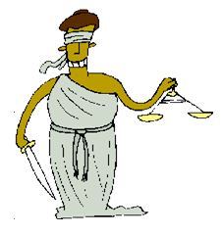
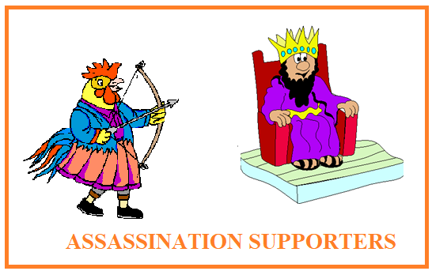
Need of Randomized Response Techniques
Money Duplication
Malnutrition
Illegal Fishing
Gambling
Illegal Border Crossing
Blind Justice
So On….

Slide 9
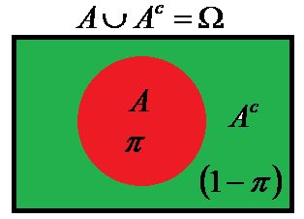
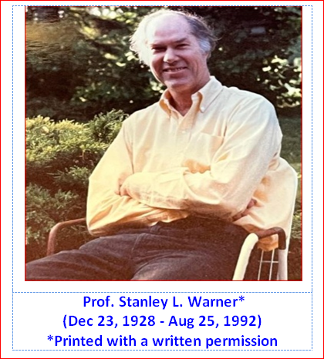

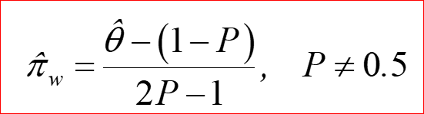
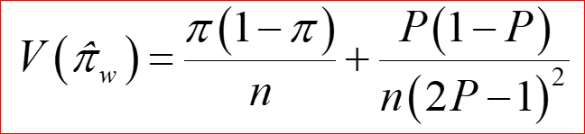
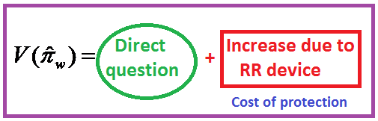
Warner (1965):
P
1‒ P
Spinner
With the known P, the maximum likelihood estimator of π is:
His idea has spawned a vast literature which has been reviewed by Fox (2016), Chaudhuri, Christofides and Rao (2016) while celebrated Golden Jubilee Year of the Warner’s RRT model during 2015.

Slide 10
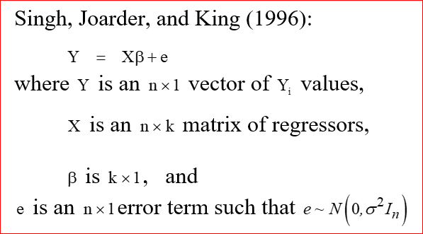
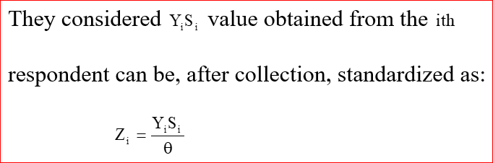
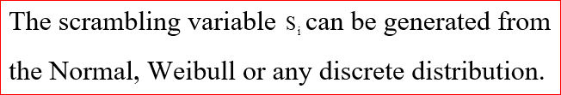
Himmelfarb and Edgell (1980) introduced the idea of additive and multiplicative scrambled randomized response models which they used to estimate the population mean of a sensitive variable by making use of the known distribution of a scrambling variable.
Eichhorn and Hayre (1983) further investigated the multiplicative scrambling approach in depth and discussed importance and limitations.

Slide 11
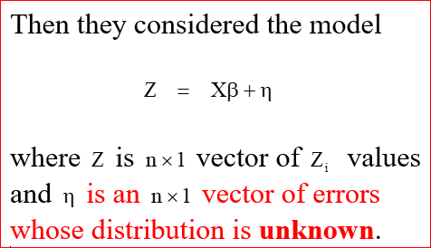
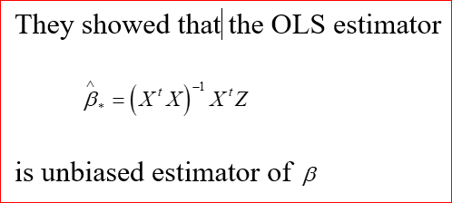
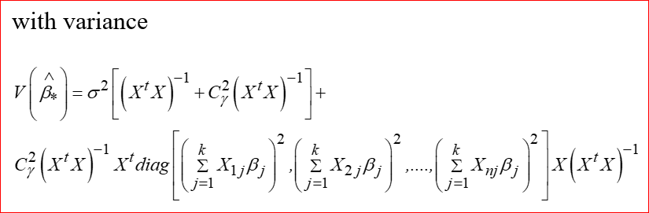

Slide 12
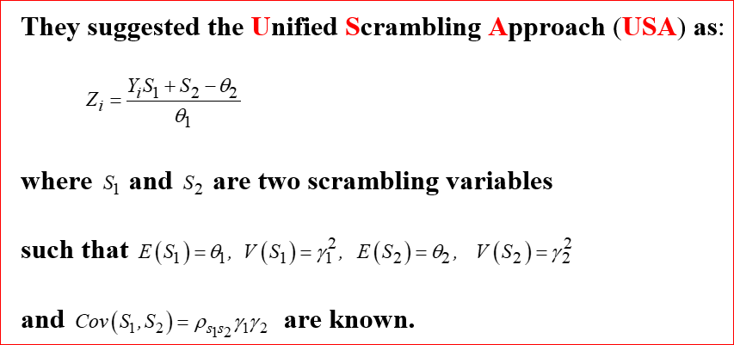

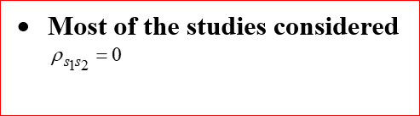
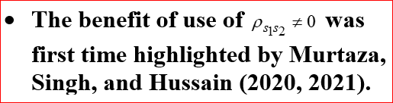
Chaudhuri and Stenger (1992) incorporated another ingenious suggestion of combining both the additive and multiplicative model together.

Slide 13

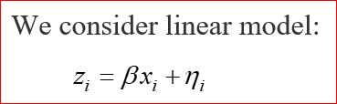
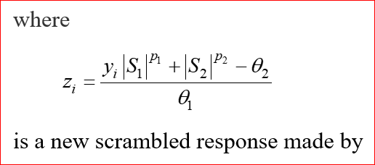
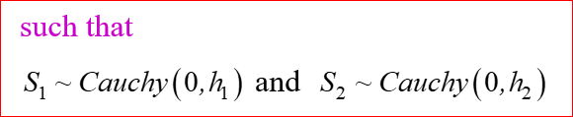

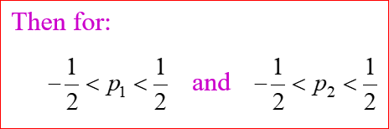

Slide 14
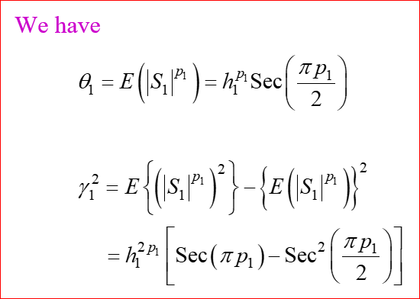
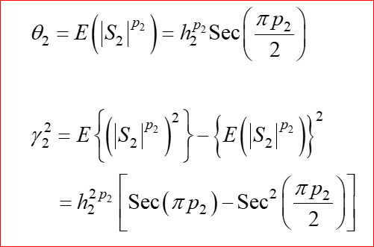
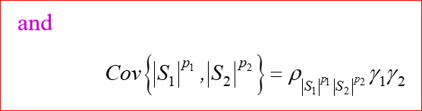
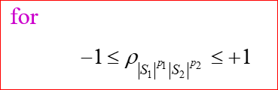
which is completely new scrambling method made by

Slide 15
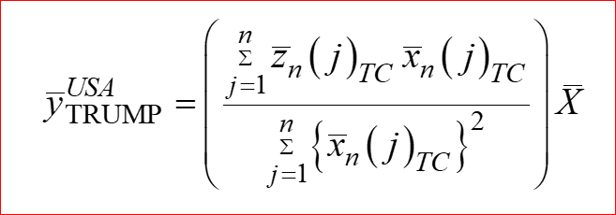
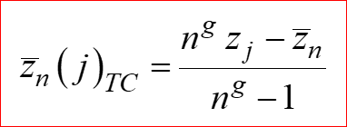
Tuned Ratio Unbiased Mean Predictor (TRUMP) with the Unified Scrambling Approach (USA)
We consider:
where

Slide 16


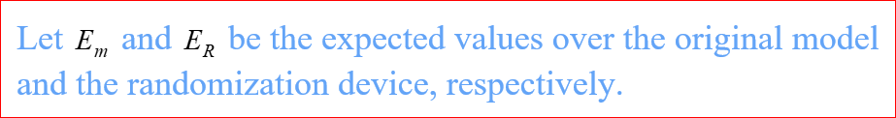
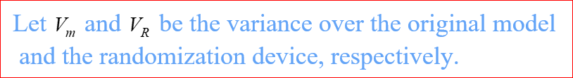
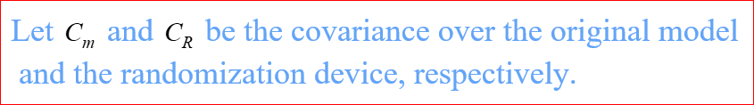
Following Singh and Sedory (2017), we have
where

Slide 17
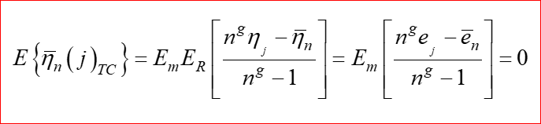
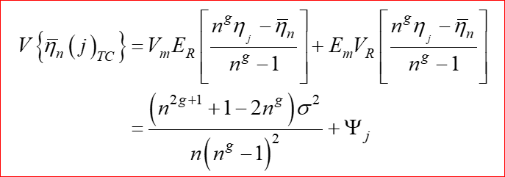
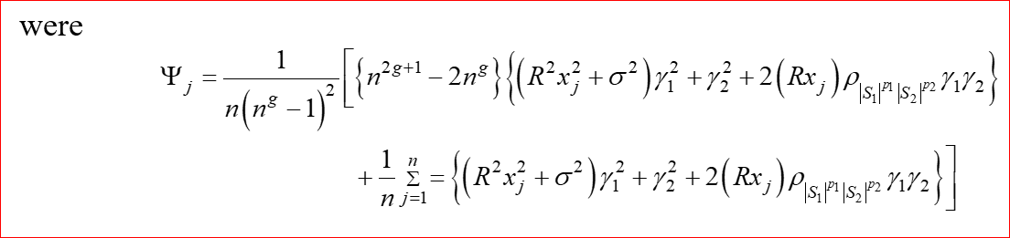

Slide 18
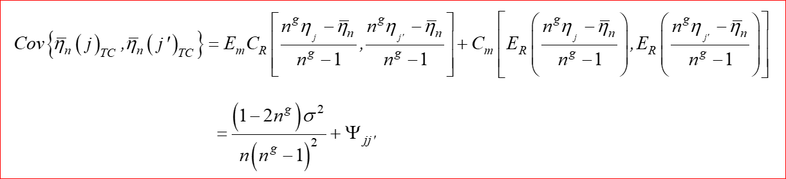
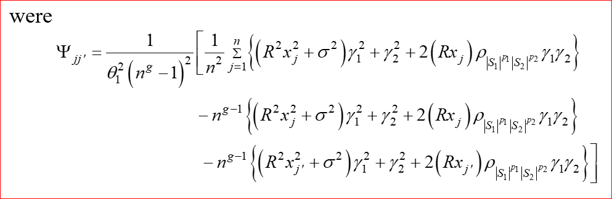

Slide 19

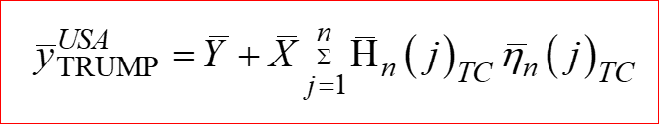
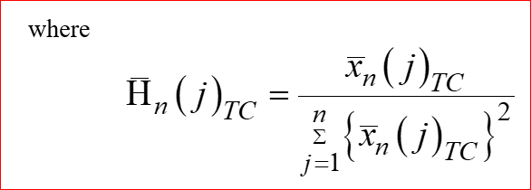


Slide 20


Slide 21


Slide 22


Slide 23



MAGA – Making a Great Adjustment
(Simulaton Study)
CRUNCHING HELPFUL TRUMP CARE COEFFICIENTS

Slide 24



Slide 25

Optimal TRUMP Care Coefficient

Slide 26

Future of TRUMP with the USA
The proposed TRUMP with the Unified Scrambling Approach (USA) opens a big-door to future research for those who are interested in using auxiliary information with scrambled responses.
Internet is full of such estimators or refer to Singh and Sedory (2017a).

Slide 27


JOIN the MS PROGRAM
THIRSTY CROW

Slide 28
Acknowledgements
The authors are thankful to the R Core Team (2022). R: A language and environment for statistical computing. R Foundation for Statistical Computing, Vienna, Austria. URL https://www.R-project.org/. This presentation is a part of a chapter in Singh and Sedory (2017b), and R codes are also included in the chapter All the opinions are of authors’ and do not belong to any institute or organization. The use of ARTEXPLOSION 600,000 in few drawings is also duly acknowledged. Any resemblance to actual persons, living or dead, or actual events is purely coincidental.
References
Chaudhuri, A. and Stenger, H.S. (1992). Survey Sampling. CRC Press, Boca-Ratan.
Chaudguri, A., Christofides, T.C. and Rao, C.R. (2016). Data Gathering, Analysis and Protection of Privacy Through Randomized Response Techniques: Qualitative and Quantitative Human Traits. Elsevier.
Cochran, W.G. (1940). The estimation of yields of cereal experiments by sampling for the ratio of grains to total produce. Journal of Agricultural Science, 30, 262-275.
Eichhorn, B.H. and Hayre, L.S. (1983). Scrambled randomized response methods for obtaining sensitive quantitative data. Journal of Statistical Planning and Inference, 7(4) , 307-316
Ferguson, T.S. (1962). A representation of the symmetric bivariate Cauchy distribution. Ann. Math. Statist., 33(4), 1256-1266.

Slide 29
Fox, J.A. (2016). Randomized Response: A Method for Sensitive Surveys. SAGE, CA.
Himmelfarb, S.H. And Edgell, S.E. (1980). Additive Constants Model: A randomized response technique for eliminating evasiveness to quantitative response questions. Psychological Bulletin, 87(3), 525-530.
Murtaza, M. , Singh, S. and Hussain, Z. (2021). Use of correlated scrambling variables in quantitative randomized response technique. Biom. J., 63(1), 134-147.
Murtaza, M. , Singh, S. and Hussain, Z. (2020). An innovative optimal randomized response model using correlated scrambling variables. Journal of Statistical Computation andSimulation, 2823-2839.
Quenouille, M.H. (1956). Notes on bias in estimation. Biometrika, 43, 353-360.
Singh, S. and Horn, S. (1998). An alternative estimator for multi-character surveys. Metrika, 48, 99-107.
Singh, S; Joarder, A.H. and King, M.L. (1996). Regression analysis using scrambled responses. Australian Journal of Statistics, 38(2), 201—211
Singh, S. and Sedory, S.A. (2017). TRUMP: Tuned Ratio Unbiased Mean Predictor. Proceedings of the American Statistical Association, Survey Research Methods Section, pp. 1746-1759.
Singh, S. and Sedory, S.A. (2019). TRUMP: Tuned Regression Unbiased Mean Predictor. Proceedings of the American Statistical Association, Survey Research Methods Section, pp. 2991-3008.

Slide 30
Singh, S. and Sedory, S.A. (2017a). TRUMP: Tuned Ratio Unbiased Mean Predictor. Working Monograph.
Tukey, J.W. (1958). Bias and confidence in not-quite large samples (abstract). Ann. Math. Statist., 29, 61 75.
Warner, S. L. (1965). Randomized response: A survey technique for eliminating evasive answer bias. Journal of the
American Statistical Association, 60,63-69
THANKS for WATCHING and ?s
sarjinder@yahoo.com

